Slide 1
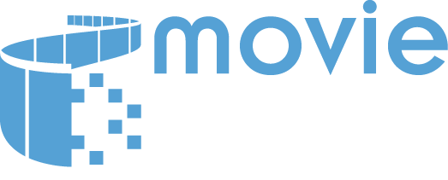
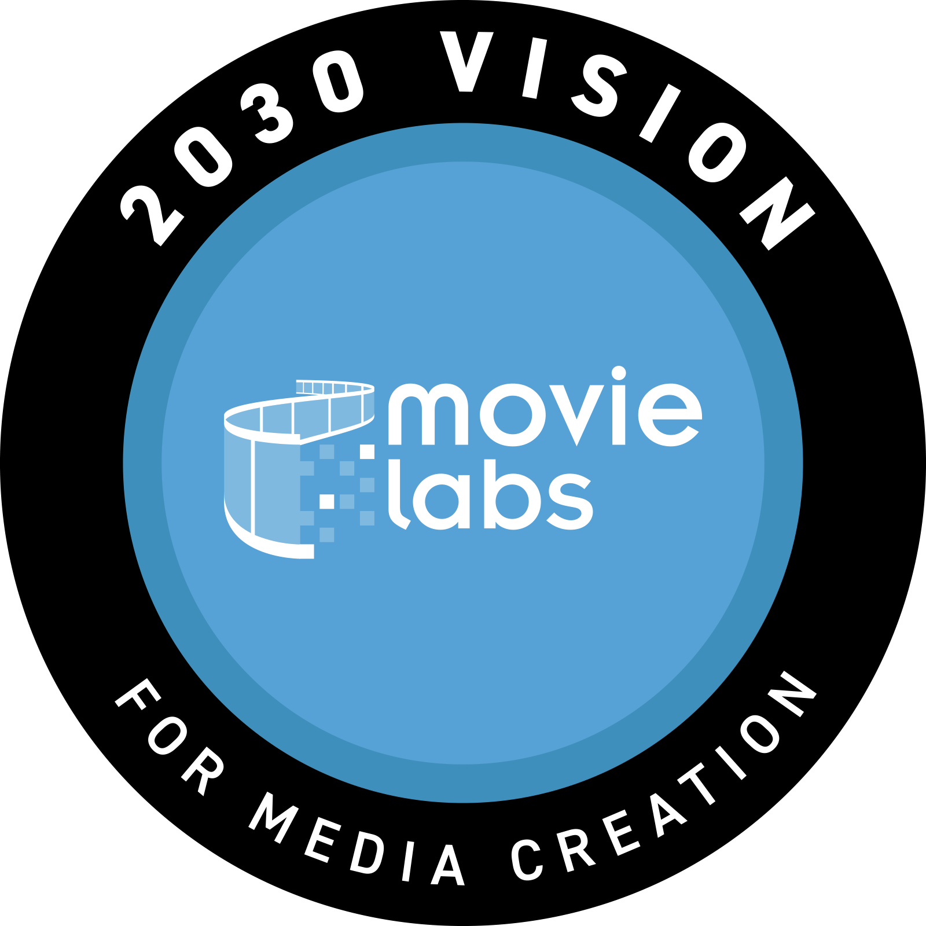
INVENTING THE FUTURE OF MEDIA CREATION
Notes:
Thanks Atul
Let me start by talking a bit about who MovieLabs is, our members, mission, our areas of focus and how we are engaging with the industry.

Slide 2
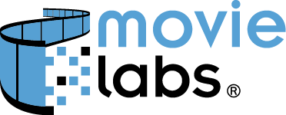

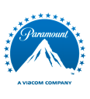



WHO IS MOVIELABS?
MovieLabs is the non-profit joint venture technology research and development laboratory / think-tank, owned by the Hollywood Studios.​
Notes:
So MovieLabs is a non profit joined venture R&D Lab owned by the 5 major Hollywood Studios.
But the real mission for MovieLabs is to tackle that common industry work that benefits all, that not one company can or should tackle on their own. In the past MovieLabs has played significant roles in defining specifications for HDR, content protection standards, the digital distribution solution calleed the MovieLabs Digital Distribution Framer work, which created specification for content delivery and metadata, other initiatives such as the Entertainment identification Registry or EIDR which provides a unique Identifier for virtually every version of every film and television show, which essentially is the backbone of the current media supply chain.
But of course, Many people know MovieLabs through the 2019 Whitepaper that was originally called CLICK

Slide 3
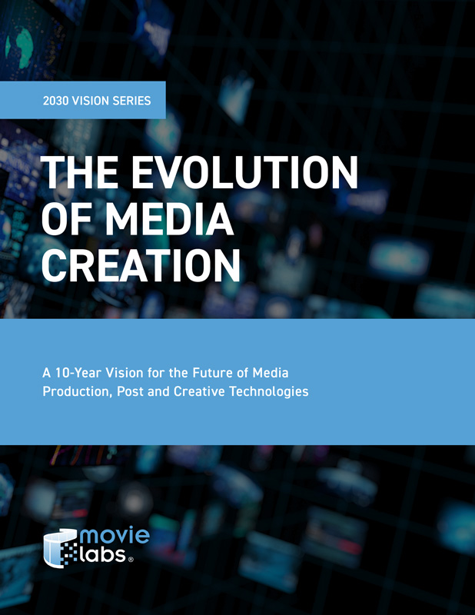
THE MOVIELABS 2030 VISION
\
The Evolution of Media Creation – a 10 Year Vision for the Future of Media Production, Post and Creative Technologies
AKA – The 2030 Vision
CONFIDENTIAL
Notes:
the Evolution of Media Creation – a 10 year vision for the Future of Media Post and Creative Technologies.
Since the paper was released at the end of 2019, this 10 year horizon became known as the 2030 Vision. But to be clear 2030 is not a target date, it is not an expiration date, it was just a time frame that allowed the authors of the paper to be able to take a long term view without being inhibited by short term thinking.
And of course, those long term thought and that Vision as inspired many. But what is important about this date is that it provides a great focus for the industry – and its 10 foundational principles have become both a North Star and industry technology implementation roadmap.

Slide 4
THE MOVIELABS 2030 VISION
\
The Evolution of Media Creation – a 10 Year Vision for the Future of Media Production, Post and Creative Technologies
AKA – The 2030 Vision
CONFIDENTIAL
Notes:
the Evolution of Media Creation – a 10 year vision for the Future of Media Post and Creative Technologies.
Since the paper was released at the end of 2019, this 10 year horizon became known as the 2030 Vision. But to be clear 2030 is not a target date, it is not an expiration date, it was just a time frame that allowed the authors of the paper to be able to take a long term view without being inhibited by short term thinking.
And of course, those long term thought and that Vision as inspired many. But what is important about this date is that it provides a great focus for the industry – and its 10 foundational principles have become both a North Star and industry technology implementation roadmap.

Slide 5

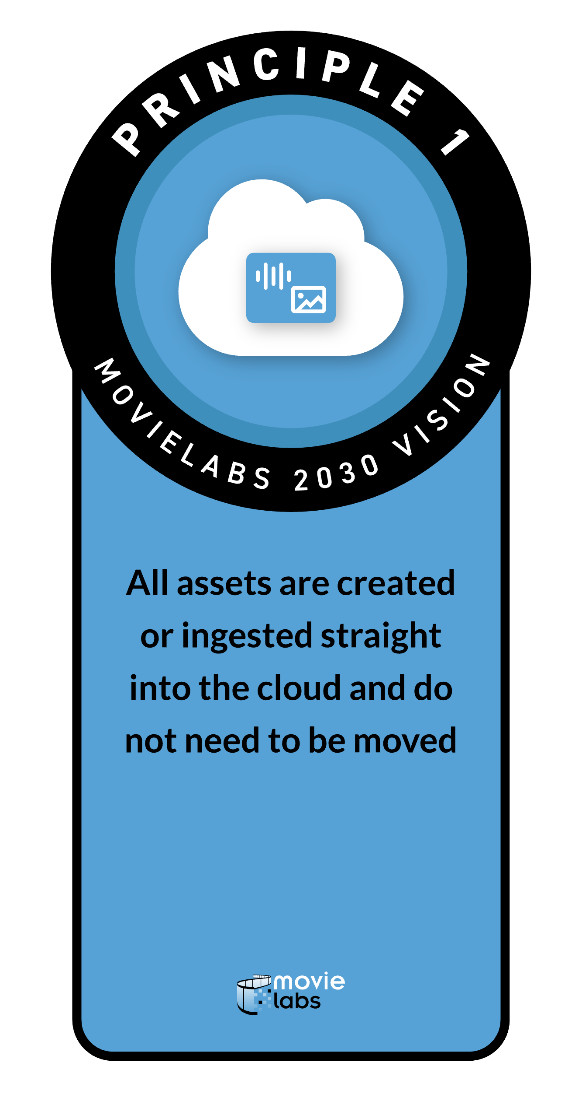
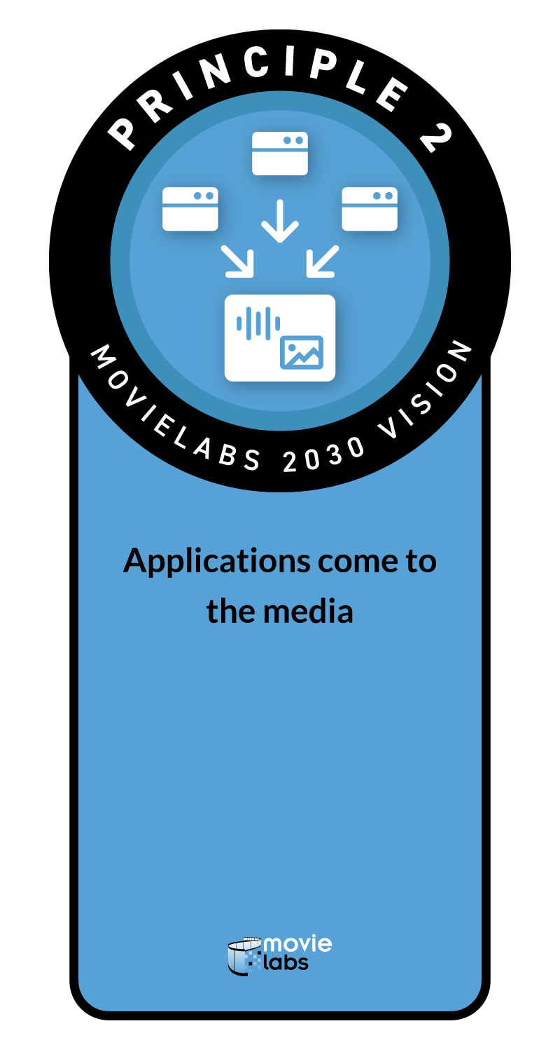
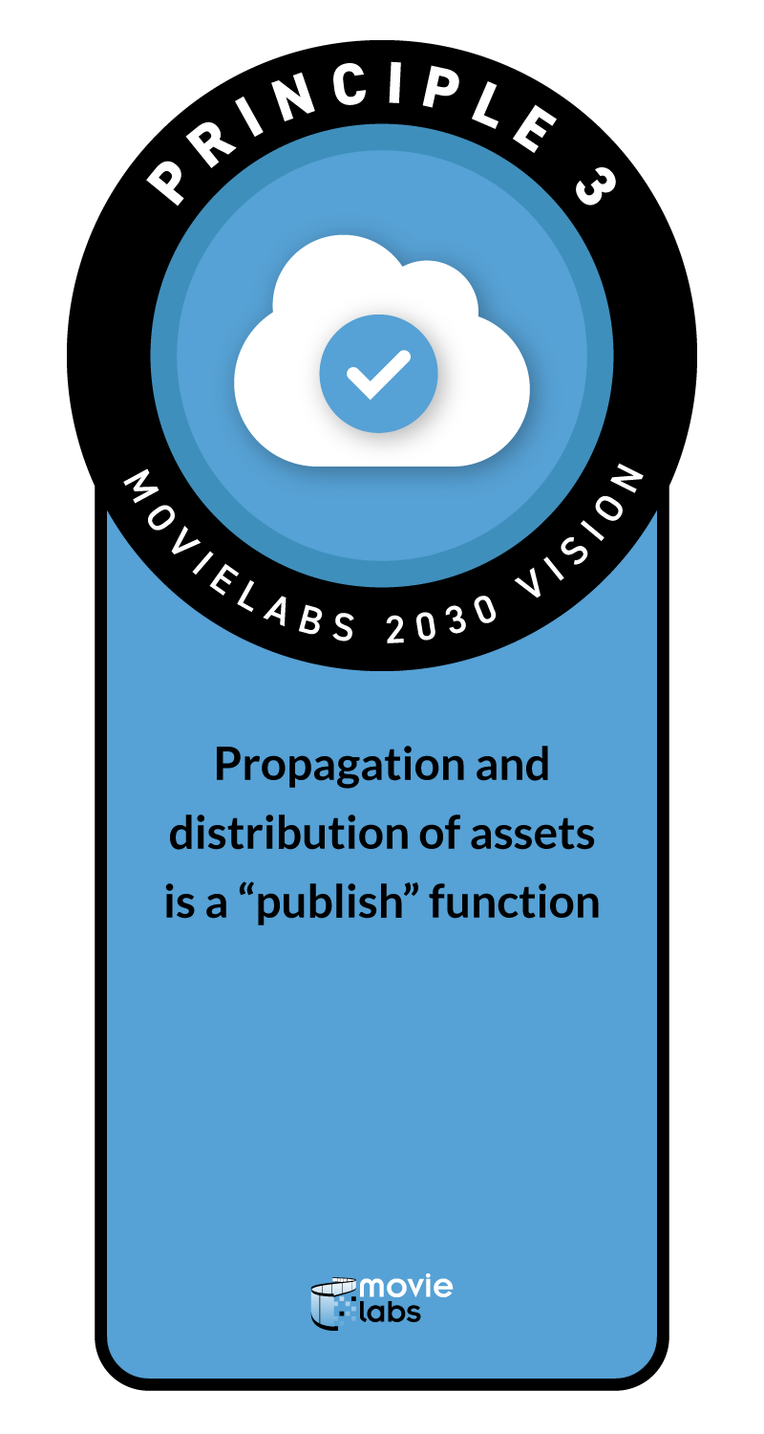
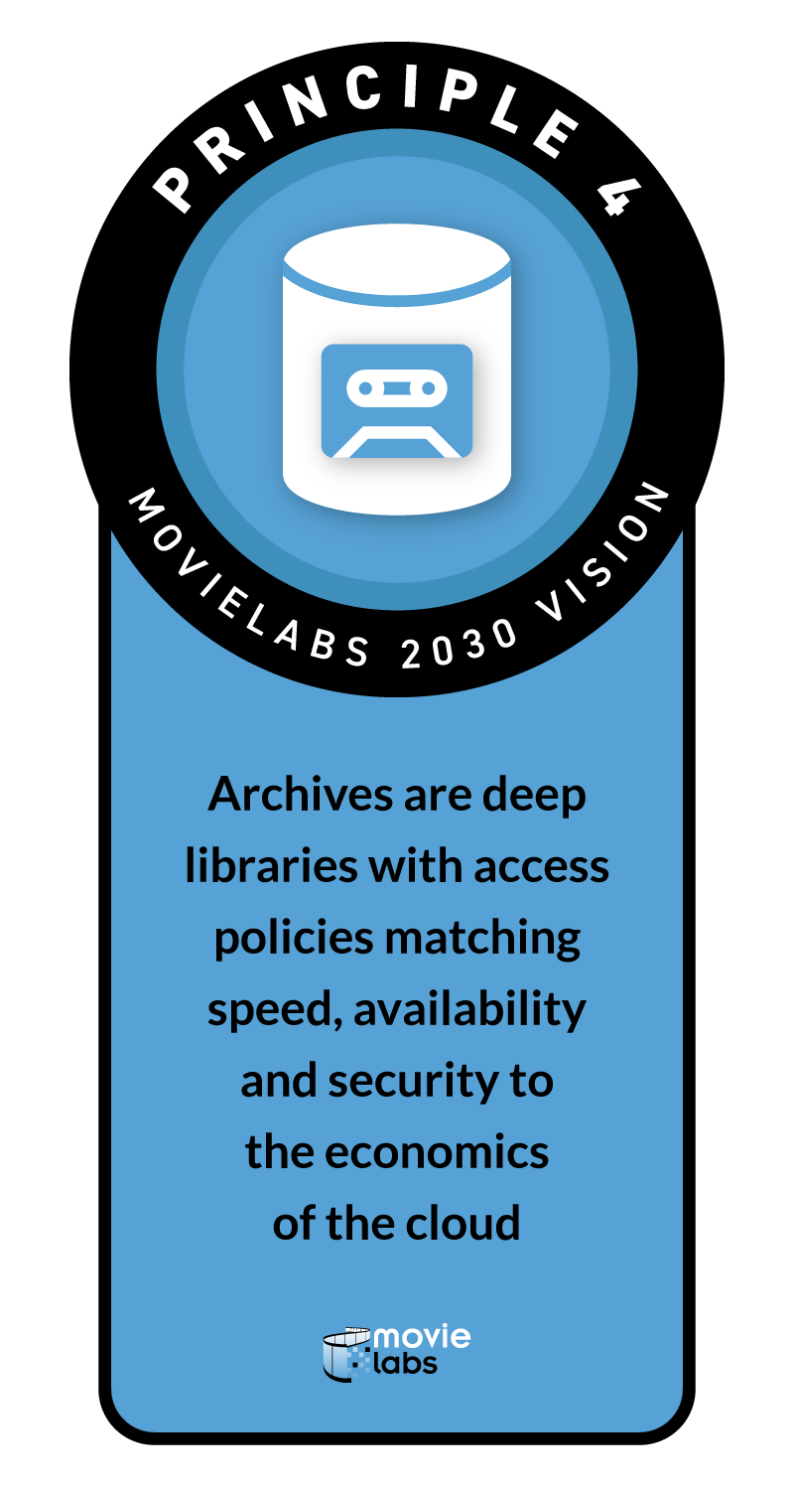
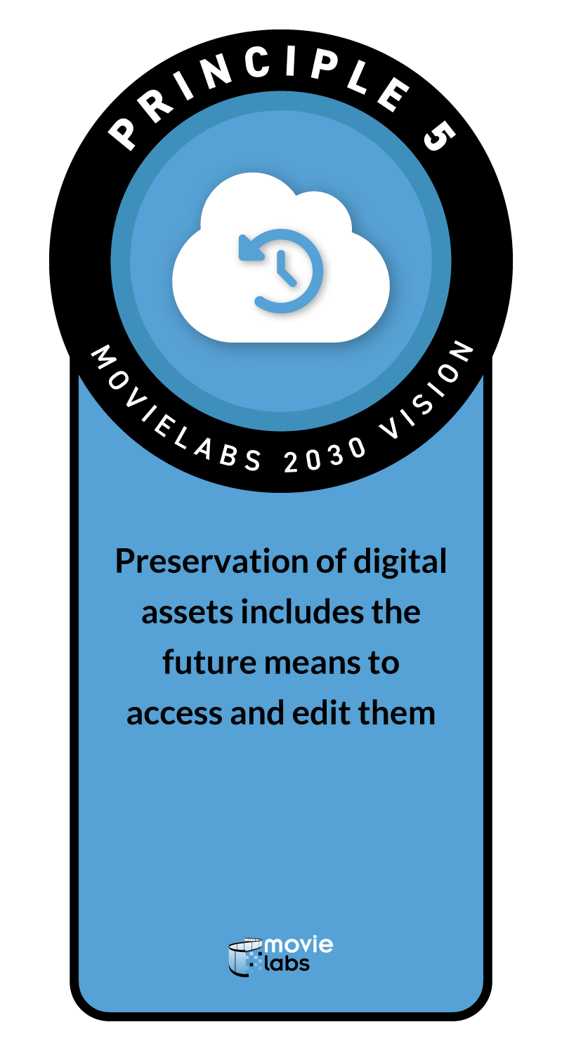
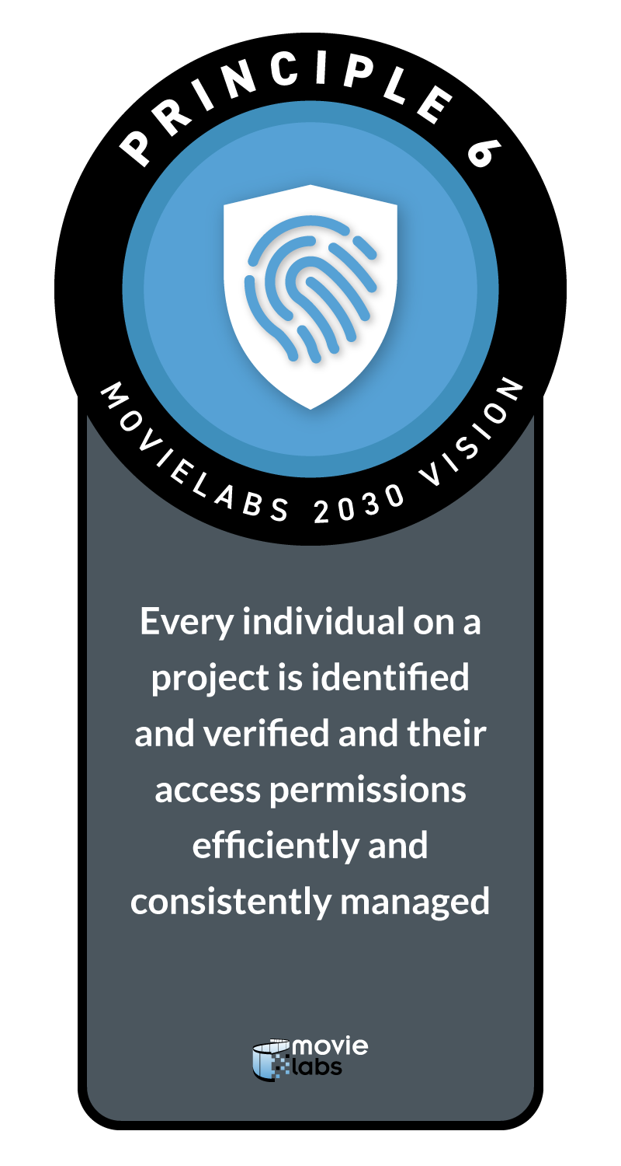
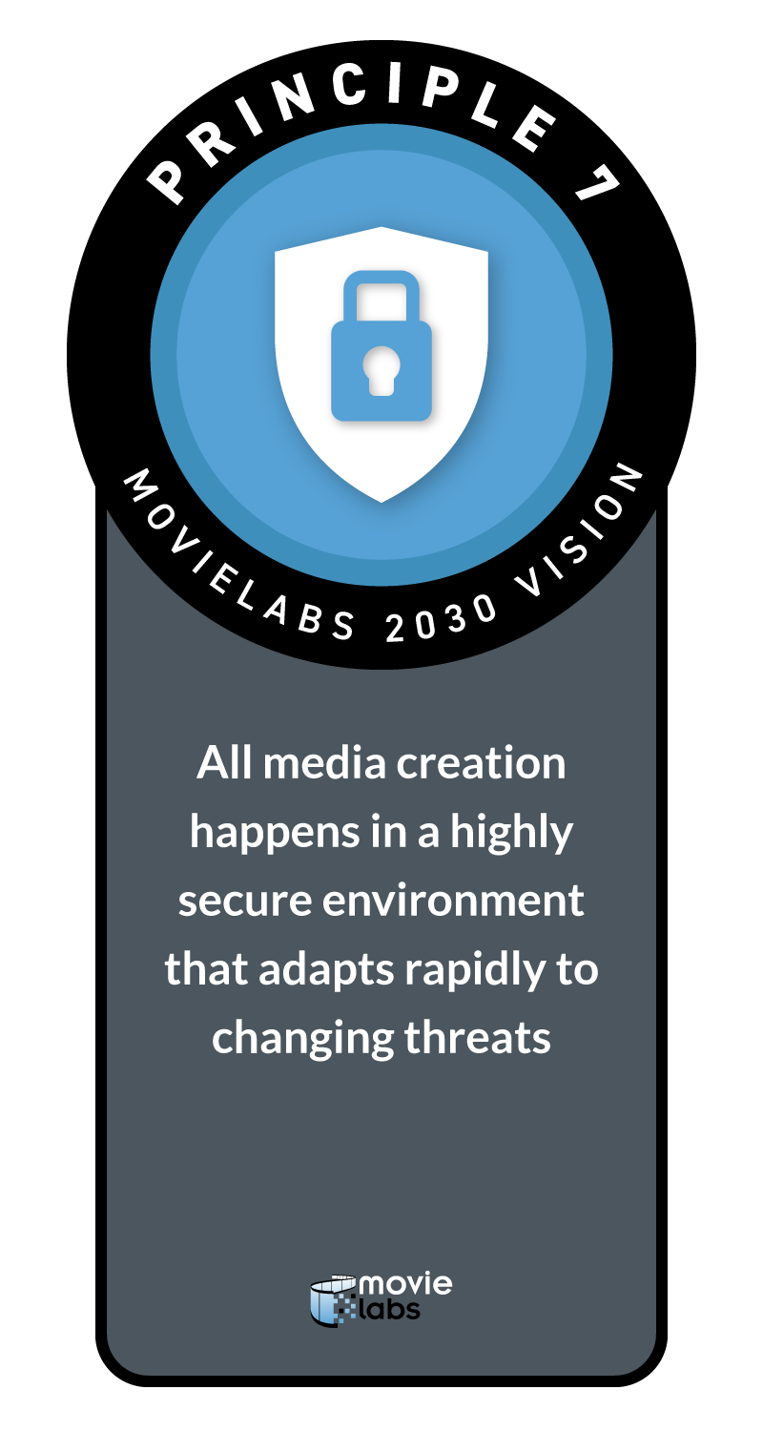
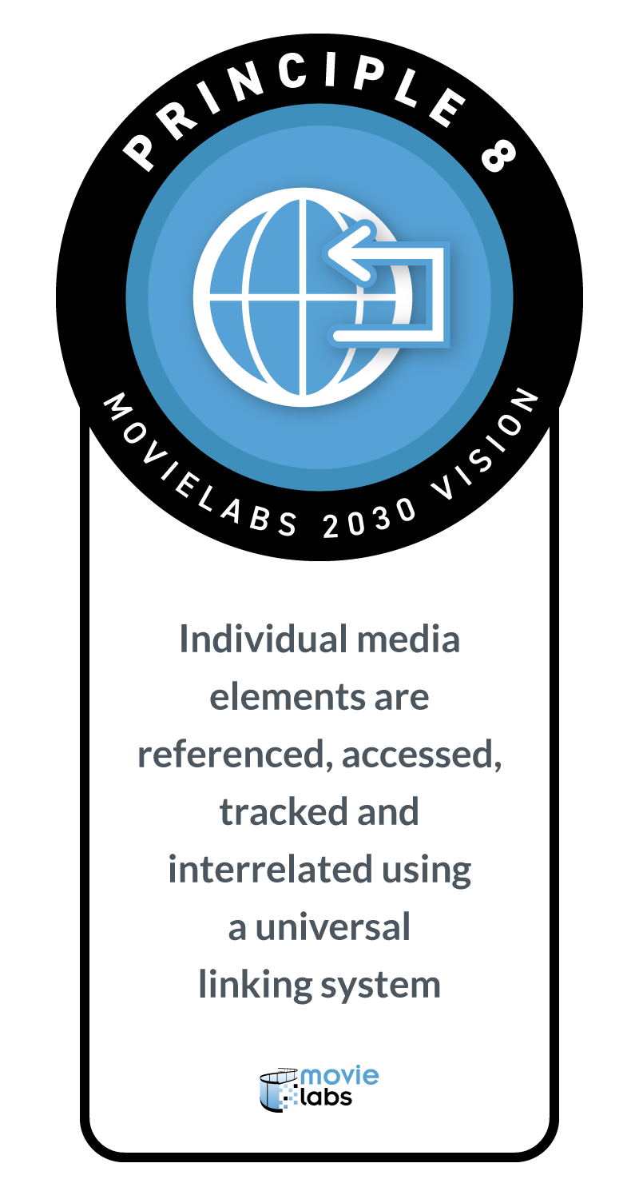
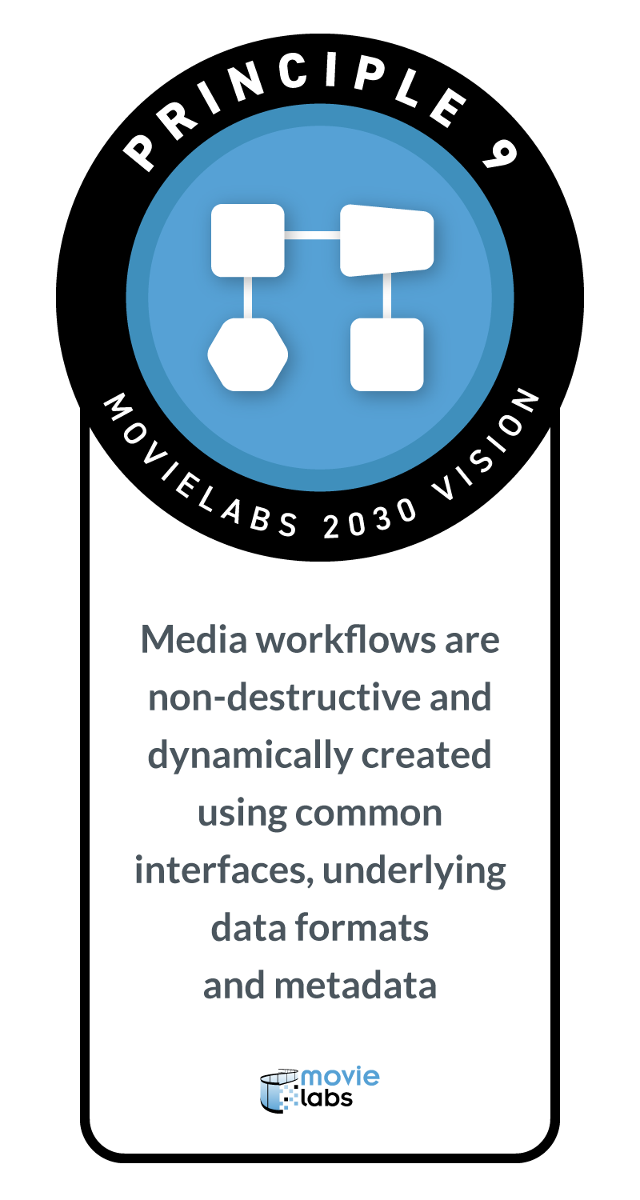
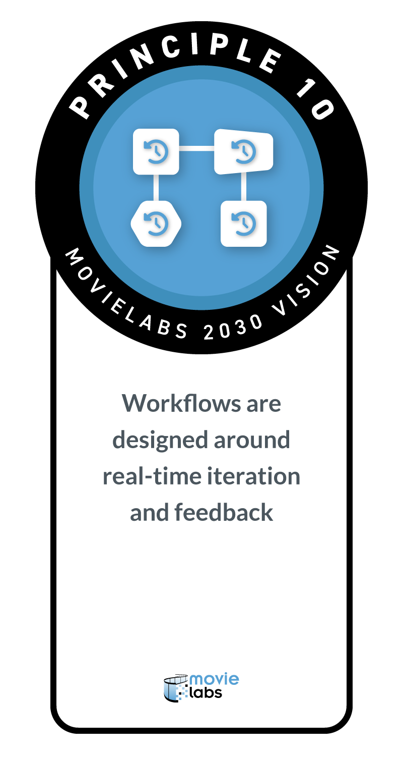
THE 10 CORE PRINCIPLES OF THE “2030 VISION”
A Cloud Foundation
Security & Identity
Software Defined Workflows
Interoperability
Notes:
I’m not going to fully drain all 10 principles here, but I do want to talk about them at a high level. The Principles fall into 3 major areas – [CLICK] Cloud Foundations / Security and Identity and Software Defined Workflows and while there is not one specific principle around interoperability [CLICK] – interop is what ties all of these principles together as ultimately the MovieLabs 2030 Vision is about how tools, workflows and infrastructures can work more securely and seamlessly together.

Slide 6
THE 10 CORE PRINCIPLES OF THE “2030 VISION”
A Cloud Foundation
Notes:
The first 5 principles lay the foundation for work in the cloud. And I think its important to talk here about what MovieLabs means by the word cloud. Cloud to us is really about connected, shared infrastructure for storage and compute. It can be provided by one of the large public cloud what are called “hyperscalers” – companies like AWS, Microsoft and Google, or a cloud could be an on premise installation of shared storage and computer or it can be a combination of public, and private on prem which are called hybrid infrastructures.
The first foundational principle states that all assets go to the cloud and are not moved. Today’s workflows are complex, messy and sometimes wasteful, because we spend a lot of time in our current workflows moving files as well as copying files so we can move them to the next stage in the workflow.
The second principle states that Applications come to the media – so instead of moving media around – the apps go to where the media is. And by the way this is hard - but there are a number of efforts underway to deliver tools that do move apps to assets.
Principles 3 is about - instead of making another copy when something needs to be seen or distributed, that distribution is more of a publish function - making it available - sending a link.
Principles 4 and 5 are about Archive. When all assets go to the cloud and do not move - your archive is already in place where you can apply a policy to the assets that say - this is an archived asset - here is who can access it and under want conditions. And of course, it is important to be able to store assets and be able to access them in the future - the long term future. We have a blog series on our website about archive with their own sets of principles.

Slide 7

THE 10 CORE PRINCIPLES OF THE “2030 VISION”
Security & Identity
Notes:
Principles 6 and 7 are focused on a new approach to security in this cloud based world where collaborators are working across multiples projects on shared infrastructure and tools that are no longer neatly protected by a security guard and some cameras.
Principle 6 is about how to authenticate and authorize permissions for people across tools and workflows and principle 7 is about the need for this new approach to security. MovieLabs has published a complete 5 part architecture that outlines this approach we call [CLICK] CSAP – or Common Security Architecture for Production
This architecture is based on the cybwesecurity notion of Zero Trust. Something the media supply chain will be hearing a lot about soon as TPN will adding audit questions about Zero Trust as the path to next generation industry securtiyt

Slide 8
THE 10 CORE PRINCIPLES OF THE “2030 VISION”
Software Defined Workflows
Notes:
Software Defined Workflows probably need a bit of definition themselves. This is about the enabling workflows that are flexible, adaptable, and interoperable, where automation gets rid of tasks that no one needs to do and literally connects tools to each other.
Principle 8 speaks to how using links to an asset creates an unambiguous way to identify them and use them without having to know where they really are. And links also provide a way to find assets associated with other assets –so for instance an image file from a camera can be linked to metadata of the what might be in that file.
Principle 9 speaks to how using common interfaces, like Apis and common data formats such as our MovieLabs Ontology for Media Creation can serve as standard building blocks so that tools and workflows can more seamlessly integrate. This makes it easier for tools to exchange assets and metadata more seamlessly and allow for tools to plug into worklows easier and in standard ways.
Principle 10 speaks to how the cloud enables real time iteration. Think about real time game engines that can provide assets in virtual production that would take days or week in visual effects. Think about how Gen AI tools can deliver iterative results in real time.

Slide 9
THE 10 CORE PRINCIPLES OF THE “2030 VISION”
A Cloud Foundation
Security & Identity
Software Defined Workflows
Interoperability
Notes:
Of course, your homework assignment is if you have not read the 2030 Vision, you should. And if you have not read it in a while, I think you’d be surprised at how prescient it is, such as how we were looking at AI 5 years ago.

Slide 10
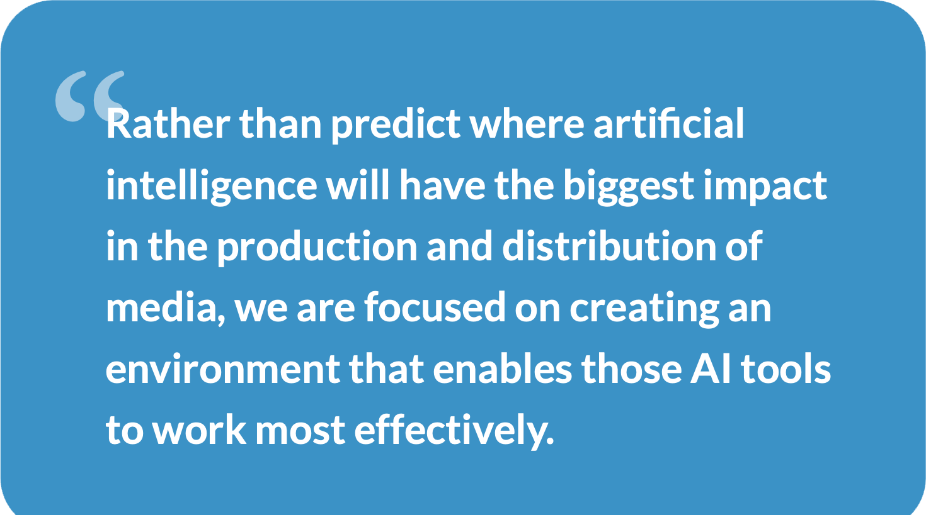
Notes:
READ QUOTE:
This quote pretty much says it all about where we are with the vision which is laying the foundation for a next generation media creation ecosystems that was designed to enable tools to work better with other tools, workflows to work better with other workflows, infrastructures to work better with other infrastructures and for tools, infrastructures and workflows to all work better together and to truly realize the promise of work that really flows. That is what the 2030 Vision is all about, just getting all the stuff that stands in the way, out of the way and to build an industry enviroment that lets creators create with what ever tools they want to use, with whomever and wherever they want to work all seamless and secure.

Slide 11
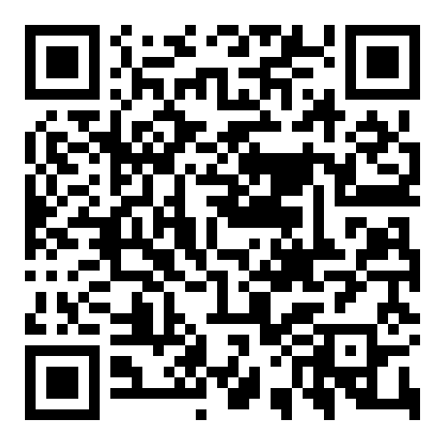
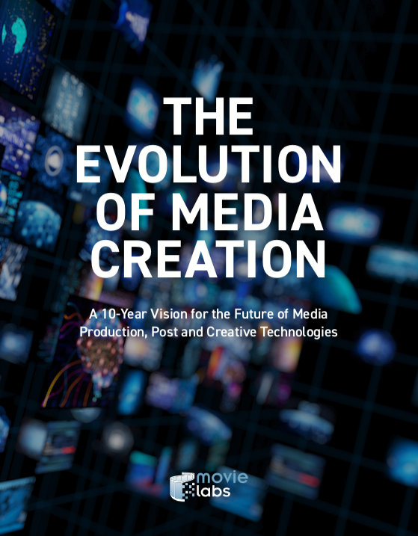
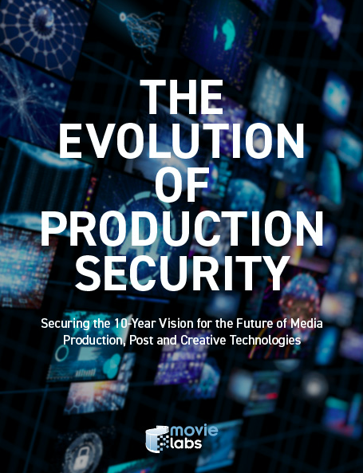
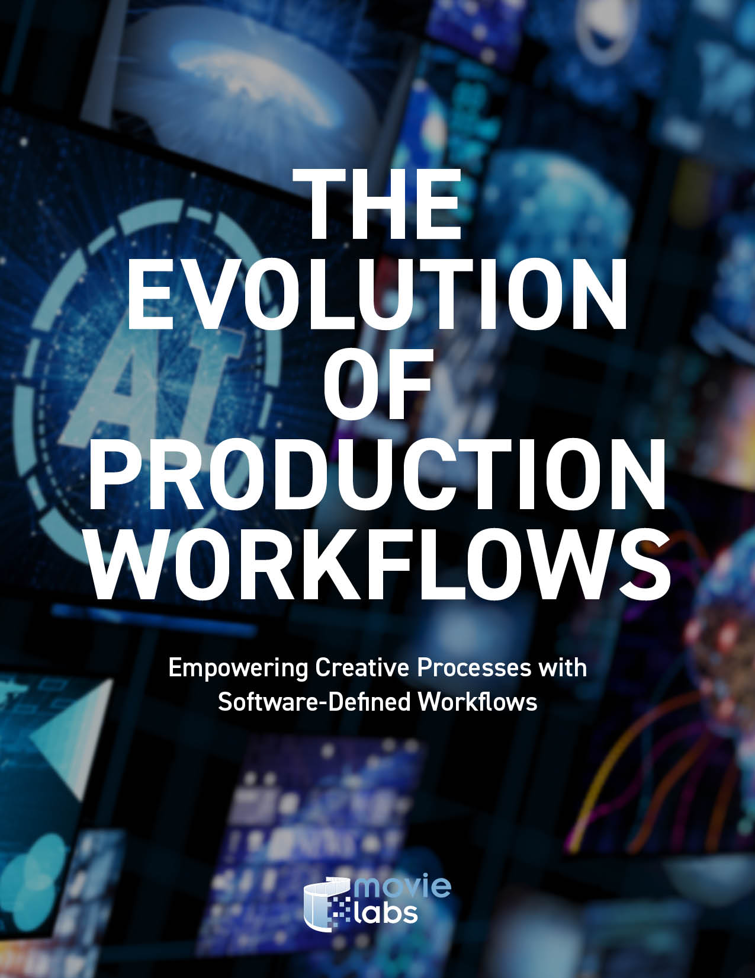
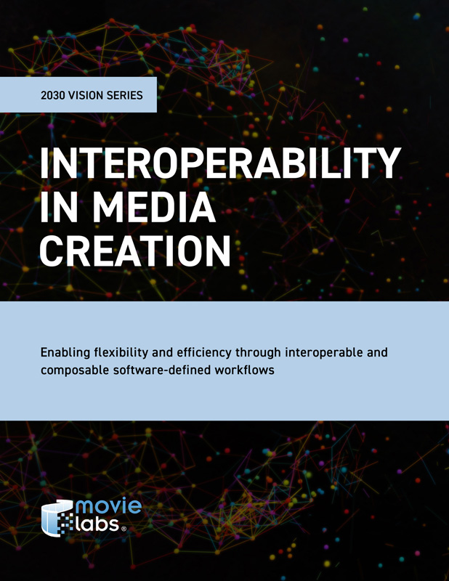
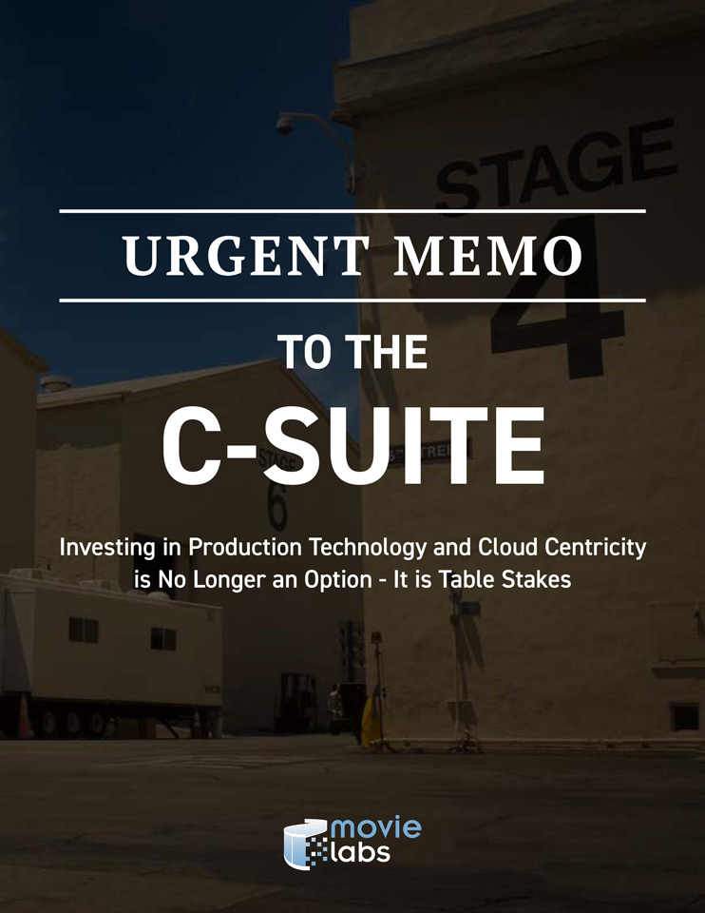
PAPERS IN THE MOVIELABS 2030 SERIES
Vision for the future of production
New security framework
Automation through SDWs
Implementing Interoperability
Summary / Call-to-action
Notes:
We have written a lot of additional white papers which “double cllick” as we like to say to go deeper into production security, workflows, interoperability and a call to action to our industry’s leaders to prepare for that future that aligned so many. These papers go deep into these topics as well as articulates a number of additional principles of what it takes to enable this future. The QR Code will take you there.

Slide 12
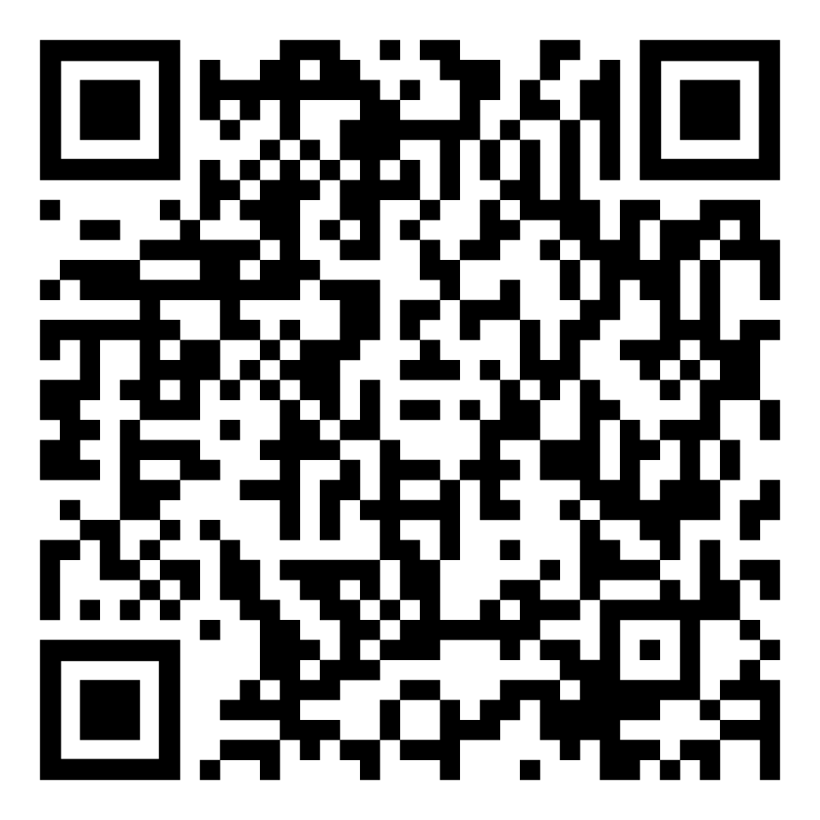



OMC
ONTOLOGY for MEDIA CREATION
TASK | PARTICIPANT | ASSET | CONTEXT | RELATIONSHIP
Write Script Previsualize Create Set Shoot Create Dailies Create VFX | WHAT THEY ARE Person Organization Service | WHAT THEY ARE Image, Video, Audio, Data, Physical Thing | NARRATIVE Scene, Location, Character, Prop | Produced By asset to task Performed By task to participant Portrayed By character to participant Depicted By prop to asset
 | WHAT THEY DO Director Actor Art Department | WHAT THEY DO Concept Art, Storyboard, Shot | PRODUCTION Scene, Location, Prop, Depiction, Slate, Shot
CONSISTENT & RELIABLE COMMUNICATIONS, GROUNDED IN COMMON LANGUAGE (Human, Visual + Machine)
CONFIDENTIAL
Notes:
And I know I brought up the topic of Ontology which is pretty obscure to people – so just want to briefly flash this up as well. An ontology is a set of concepts and categories in a specific area that shows the properties and relations between them. What is important to note about our ontology is describes a pretty unique world of the script and the story – the Narrative – and the real world in which we make movies. So that we can create connections between things like the location is Mars, but the shot was shot in New Jersey. There is an actor that plays the lead, but there is cG model as well, a stunt double, a hand double and the action figure who are all the same character. The ontologty which can be used in a graph data base is one of those common data models that litteresly connect the dots in workflows. If you wan to know more there is a full documentation site including Jason code to use in your own applications.

Slide 13
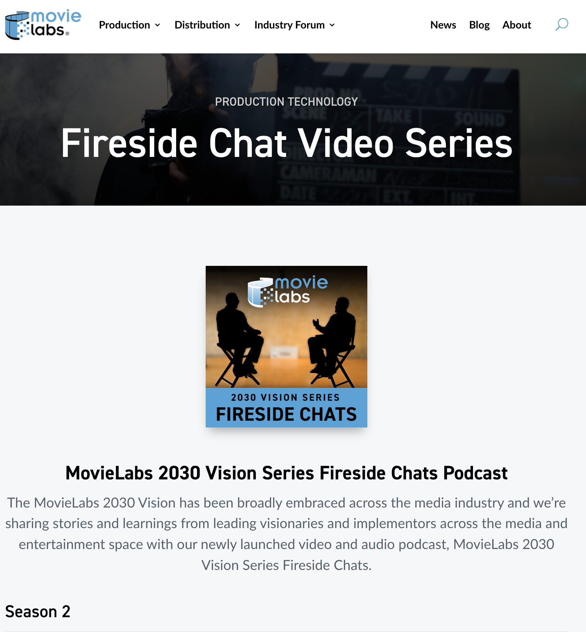
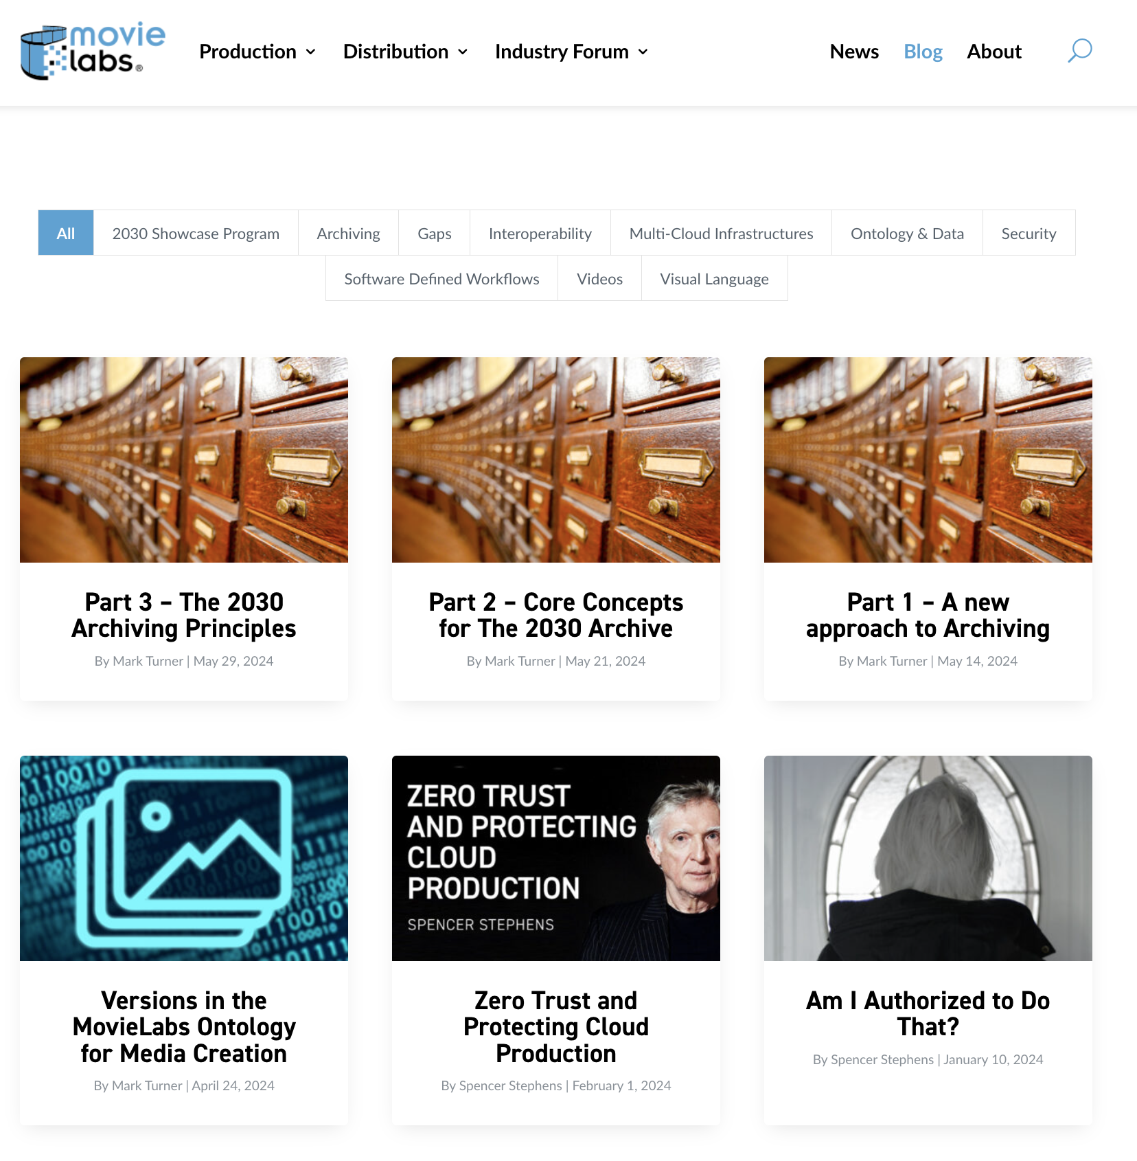
MOVIELABS BLOG SERIES MOVIELABS FIRESIDE CHAT SERIES
MOVIELABS PROVIDES SIGNIFICANT RESOURCES FOR THE INDUSTRY
CONFIDENTIAL
Notes:
But wait there’s more. Our Blog series provide great high level explainers of the MovieLabs Vision, concepts and focus areas. And our Fireside Chat series with interviews with industry leaders from Amazon, Adobe, Avid and others who talk about their own journey in how these companies are implementing the 2030 Vision.
We have video explainers in every section of our website. We have documentation for our ontology, and security. We just have a lot of resources for our industry because there is a great deal of momentum toward implementation.

Slide 14
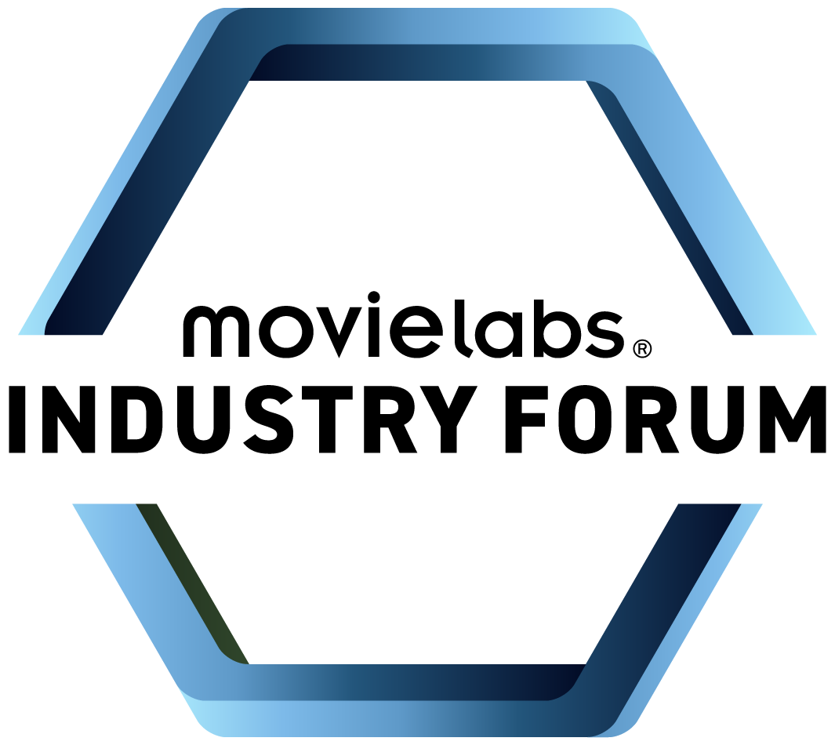
FORUM
Noun
A place, meeting, or medium where ideas and views on a particular issue can be exchanged.
Notes:
Which is why we have launched our MovieLabs Industry Forum. The Forum is where global companies big and small are coming together to share their experiences and journey on the road to implementing the 2030 Vision,

Slide 15

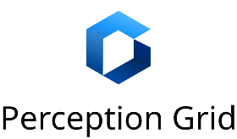




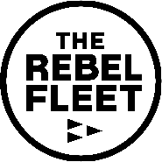

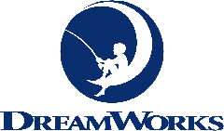







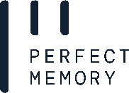
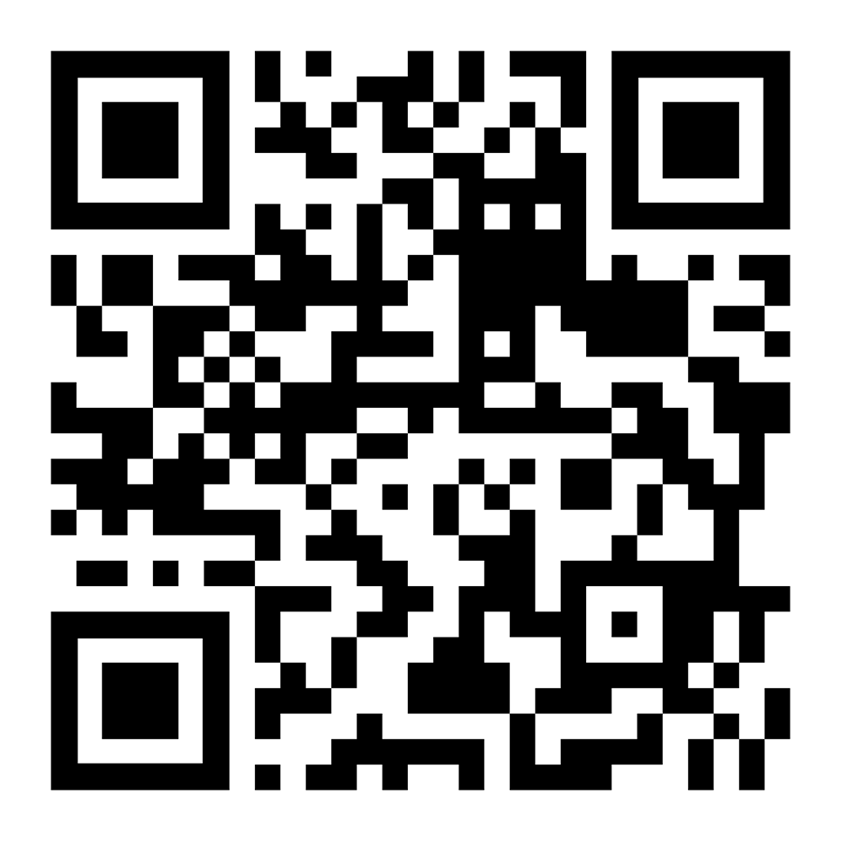


Notes:
We just launched the Forum at the beginning of the year and already we are a growing global community. We have member from the US, Canda, UK, France, Germany, Spain, New Zealand, India and Japan. We represent companies that serve production, image and sound post production, VFX, collaboration, broadcast and live to cloud services. We have systems integrators, security domain experts, we have media asset management tools, we have storage collaboration solutions, and software that serves across end to end workflows.
And if your company is committed to implementing aspects of the 2030 Vision, we invite you to join us. The QR code is on the screen

Slide 16
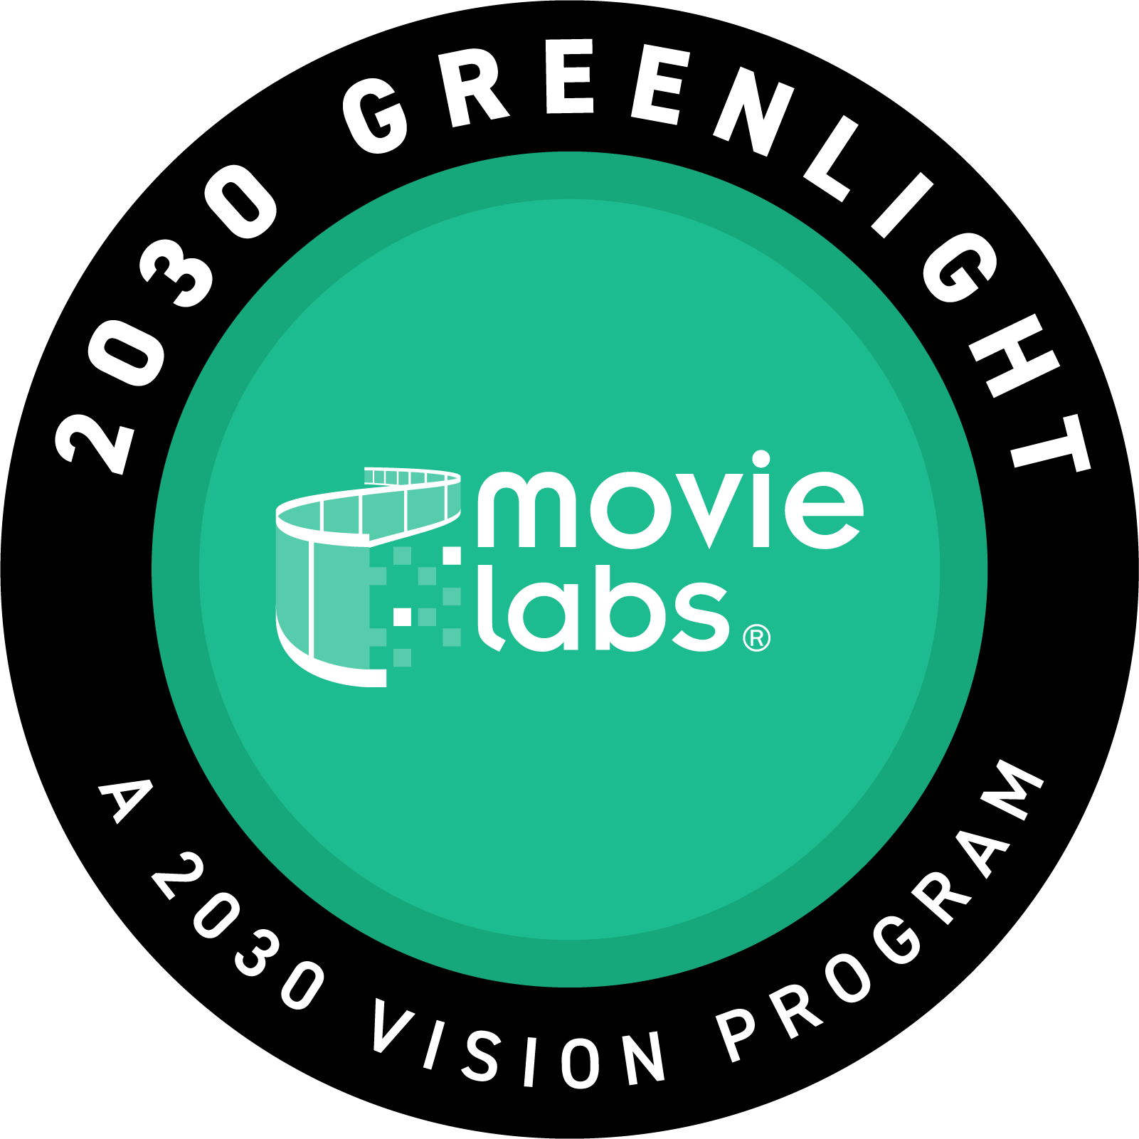
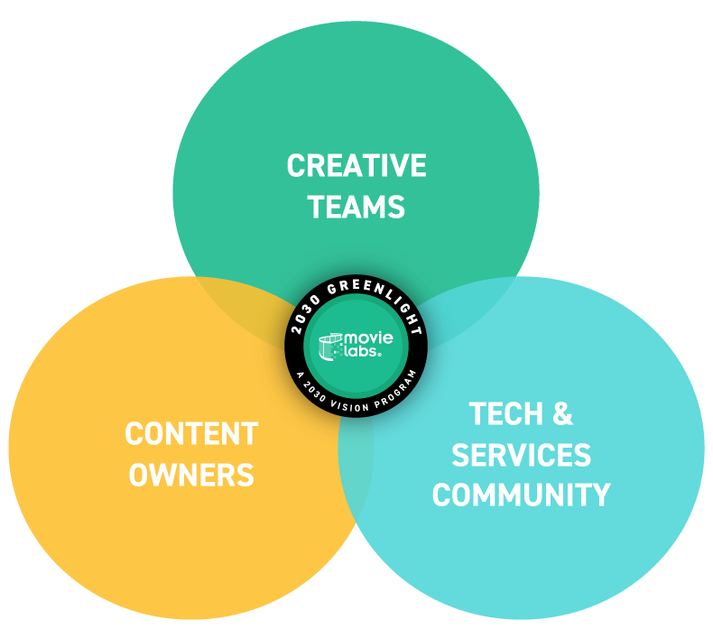
2030 Greenlight
Making interoperable 2030 workflows real and actionable
Curated Vignettes
select real-world production scenarios that are inefficient today
Prove by
Doing
connect data, tools, vendors, services to make work, flow
Demonstrate the Creative Benefits
of interoperability via
2030 Workflows
Bringing the studios, tech & services and creative communities together to deliver on the promise of the 2030 Vision.
Notes:
And here is what this is all about – We have been doing all of this work over the past 5 years for and in the name of the creative community, Our 2030 Greenlight initiative is all about demonstrating the benefits of the 2030 Vision both to and with the creative community. We are doing this by working together with both Forum members and industry players to demonstrate how tools and workflows that work together in a more 2030 way provides benefit. Our furst Greenlight demonstration was at this years HPA Tech Retreat. We demonstrated how a change in the script during production today causses all hell to break loose, but in this demonstration we watch how a change in the script tool propagated through a workflow that include AI teaching AI how to do the best concept art for the change and to show the real value of how Ontology for Media Creation literally connects the dots. This is all about proving by doing. And the response has been overwhelming.

Slide 17
FORUM
Noun
A place, meeting, or medium where ideas and views on a particular issue can be exchanged.
Notes:
I’m so excited about the momentum in the industry to adopt and implement the 2030 Vision. And I appreciate the opportunity to talk about it. If this resonates with you. We would love to have your voice around our table.

